Slide 1
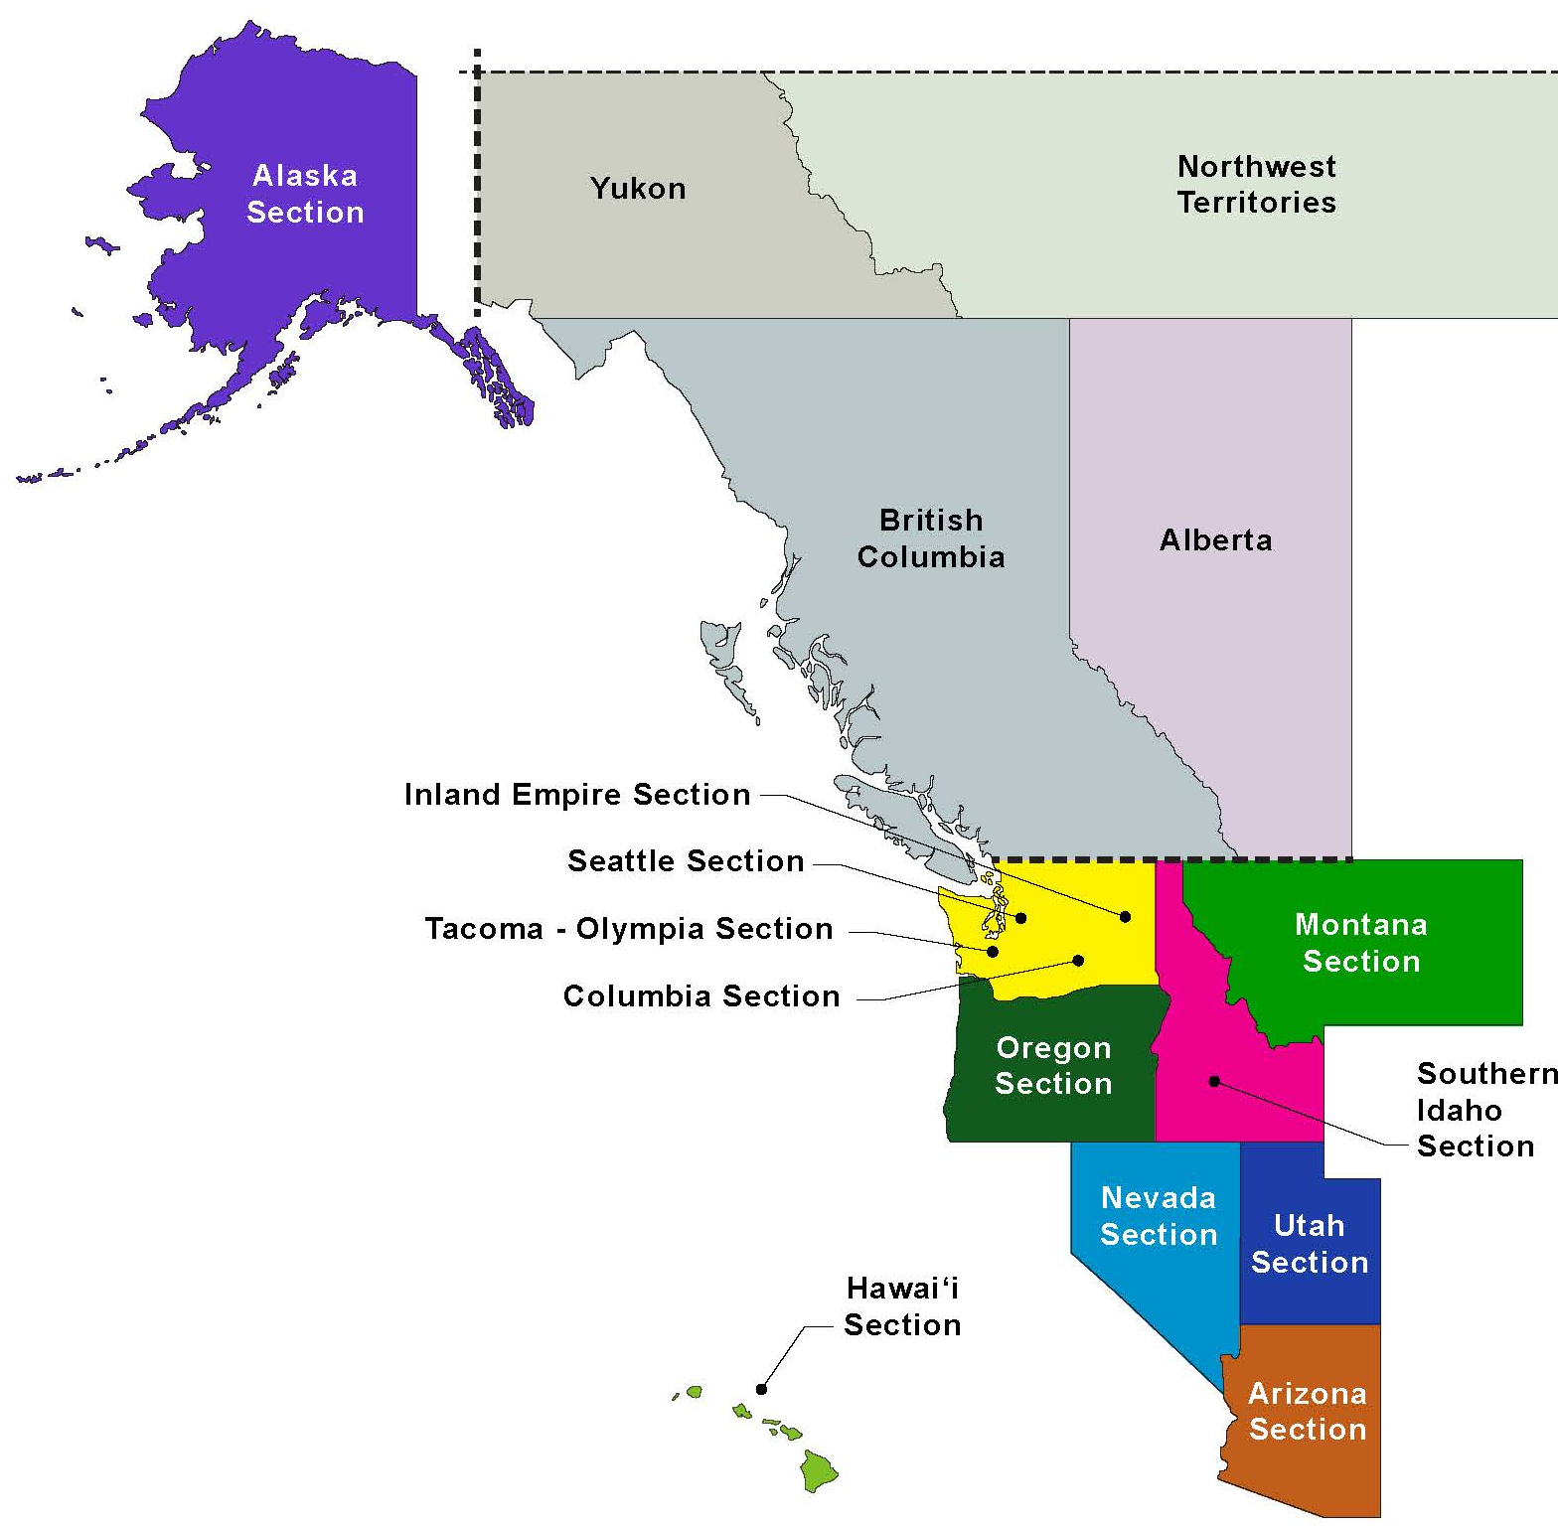
REGION 8
UPCOMING REGION 8 EVENTS
Region Governor Activities
Winter Region 8 Board of Governors Meeting, Salt Lake City, UT, Feb 3, 2022
Winter Region 8 Assembly Meeting, Salt Lake City, UT, Feb 4 and 5, 2022
Workshop of Section, Branch, & Institute Leaders, Virtual, Feb 9 to 11, 2022
Workshop for Student Chapter Leaders – Held with 2022 Student Conference Symposia – Dates Vary
Western Regional Younger Member Council, Salt Lake City, UT (Summer 2022)
Fall Region 8 Board of Governors Meeting, Walla Walla, WA, Aug 18, 2022
Fall Region 8 Assembly Meeting, Walla Walla, WA, Aug 19 and 20, 2022
2023 MRLC for Regions 8 & 9, Orange County CA (January or February 2023)
GOVERNORS 7
#Region8isGreat
9
REGION 8 BOARD
COMMITTEES
“HELP YOU MATTER MORE AND ENABLE YOU TO MAKE A BIGGER DIFFERENCE”
AWARDS
NOMINATIONS
SOCIAL
STUDENT
COMMUNICATIONS
FINANCE
MEMBERSHIP
CANADA OUTREACH
CONFERENCES
REGION 8 (USA & WESTERN CANADA)
https://regions.asce.org/region8/
2
REGION BOARD
FACE TO FACE MEETINGS
REGION 8
INFRASTRUCTURE REPORT CARDS
REGION 8 BOARD TELECONFERENCES
12
2017 Alaska
2020 Arizona
2019 Hawaii
2018 Idaho
2018 Montana
2018 Nevada
2019 Oregon
2020 Utah
2019 Washington
2
REGION 8 ASSEMBLY
FACE TO FACE MEETINGS
+70
ANNUAL GOVERNOR VISITS TO THE REGION’S GEOGRAPHIC SECTIONS & BRANCHES
VISIT https://www.infrastructurereportcard.org/state-by-state-infrastructure/
FOR MORE INFO
REGION 8 STRUCTURE
12
ASCE SECTIONS
25
ASCE BRANCHES
ASCE
REGION 8
2
STUDENT CONFERENCES
PACIFIC NORTHWEST STUDENT CONFERENCE SYMPOSIUM
UNIVERSITY OF BRITISH COLUMBIA
(April 28-30, 2022)
INTERMOUNTAIN SOUTHWEST STUDENT CONFERENCE SYMPOSIUM
UNIVERSITY OF NEVADA – LAS VEGAS
(Dates TBD)
14
YOUNGER MEMBER GROUPS
31
ASCE STUDENT GROUPS

