Slide 1
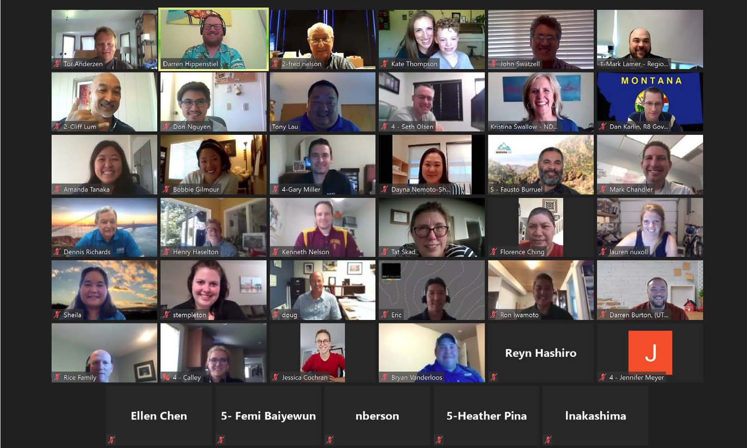
INTRODUCTION TO Great REGION 8

Slide 2
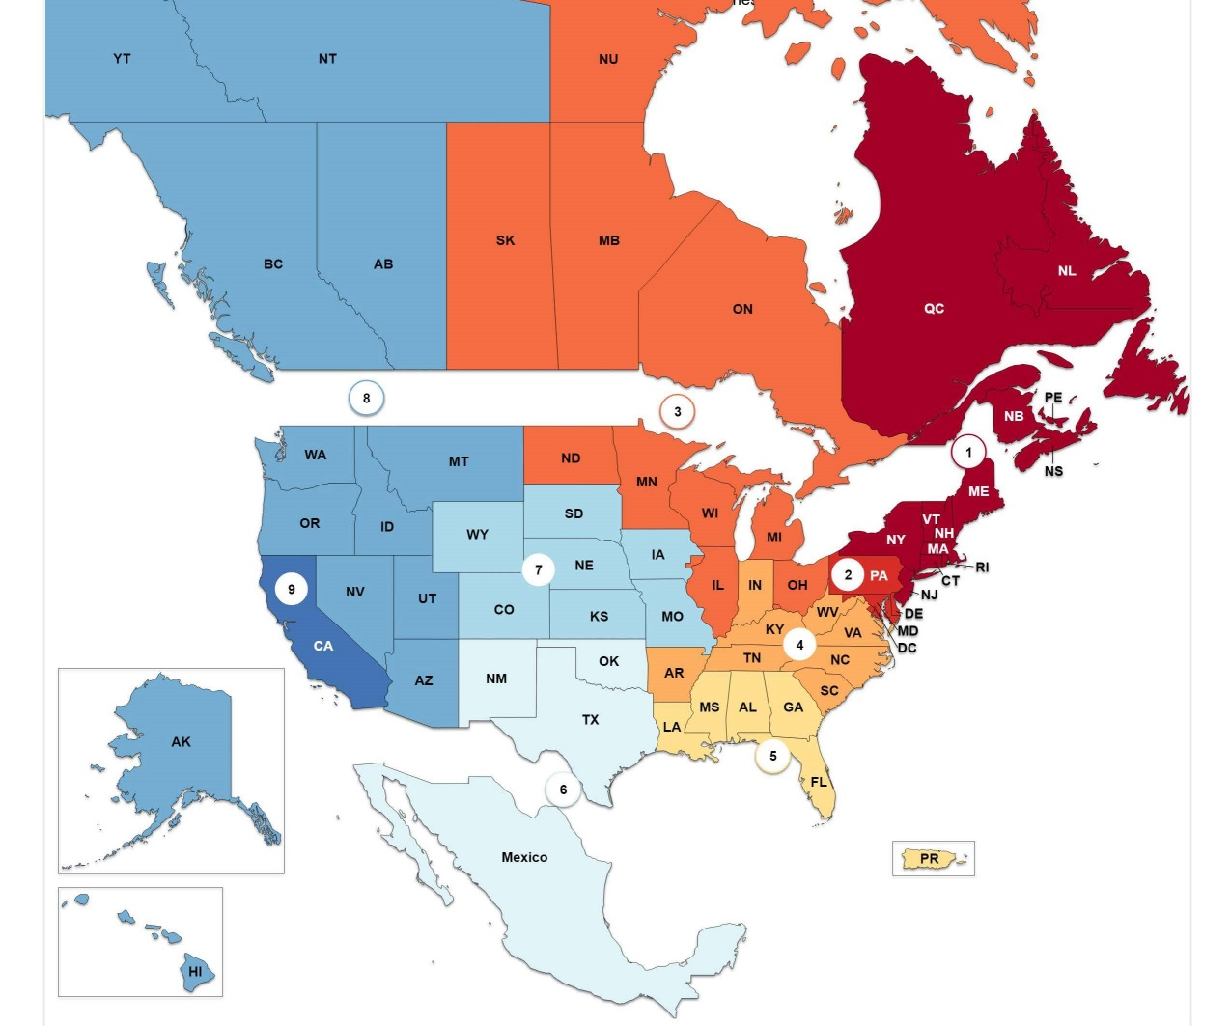
ASCe Today
10 Geographic Regions
177 Countries
150,000+ Members
One Technical Region
Nine Institutes

Slide 3
ASCE geographic units GOVERNANCE STRUCTURE
Society Board of Direction / Executive Committee
Region 8 Board of Governors / Assembly
12 Sections within
Region 8
Other Region Board of Governors (9 Geographic and 1 Technical)

Slide 4
ASCE Board of Direction
ASCE President
ASCE Past President
ASCE President Elect
Society Director Region 1
Society Director Region 2
Society Director Region 3
Society Director Region 4
Society Director Region 5
Society Director Region 6
Society Director Region 7
Society Director Region 8
Society Director Region 9
Society Director Region 10
At-Large Director (1)
At-Large Director (2)
Society Director Technical Region (1)
Society Director Technical Region (2)
Society Director Technical Region (3)
There are 2 Region 8 Members on the BOD!

Slide 6
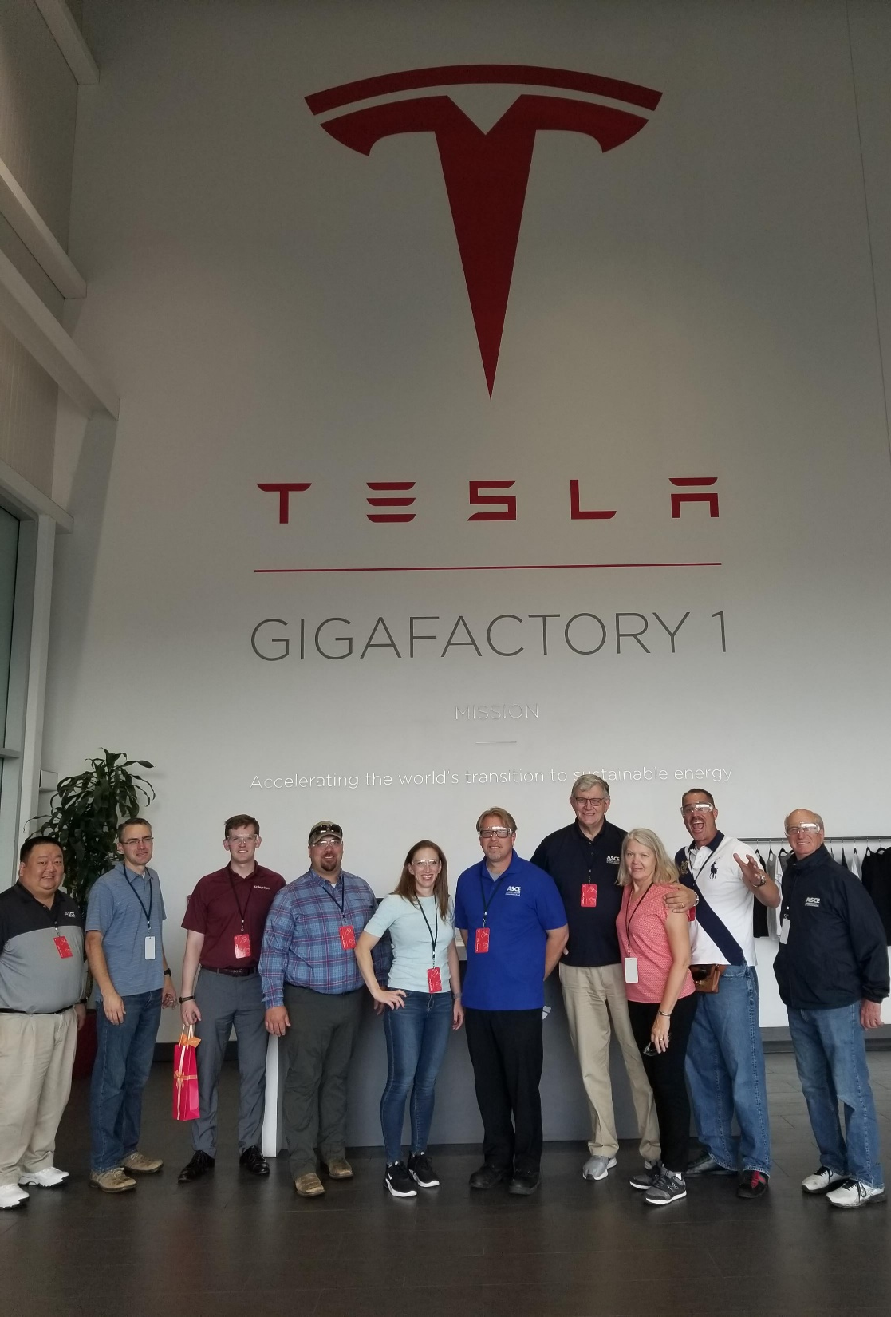
REGION 8 Board of governors

Slide 7
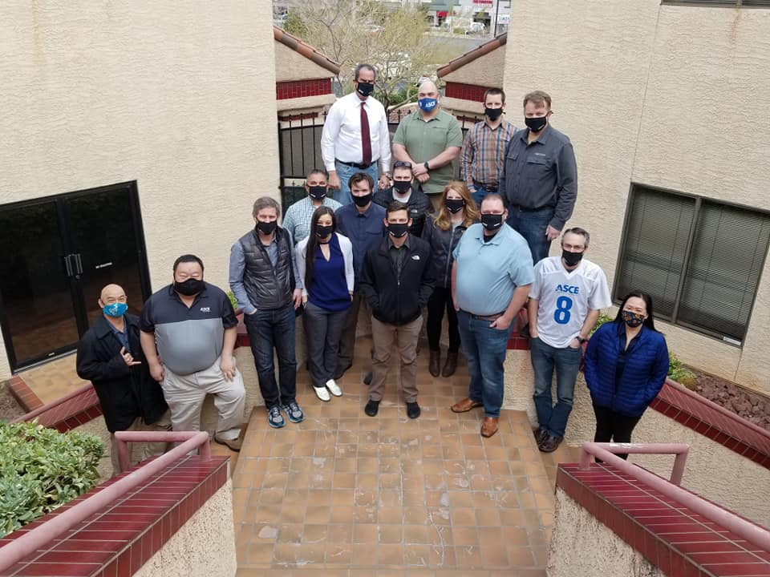
Region 8 Assembly

Slide 9
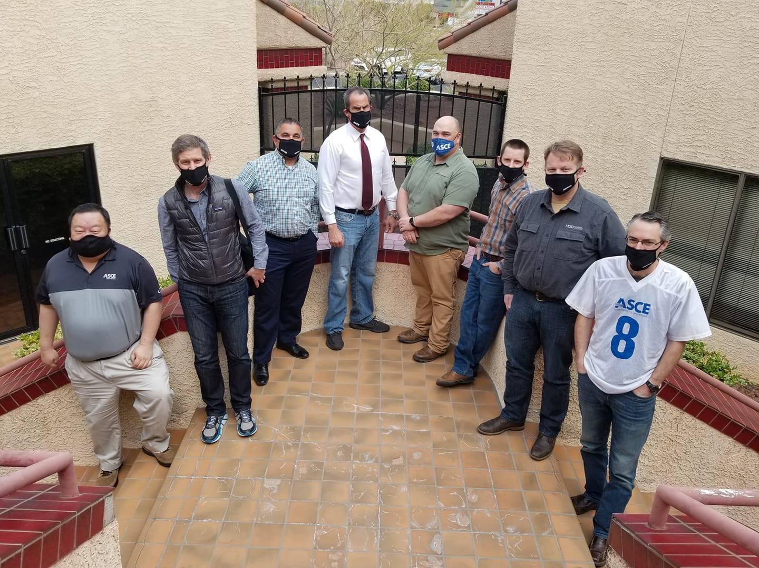
MEET YOUR REGION 8 Board of governors

Slide 10
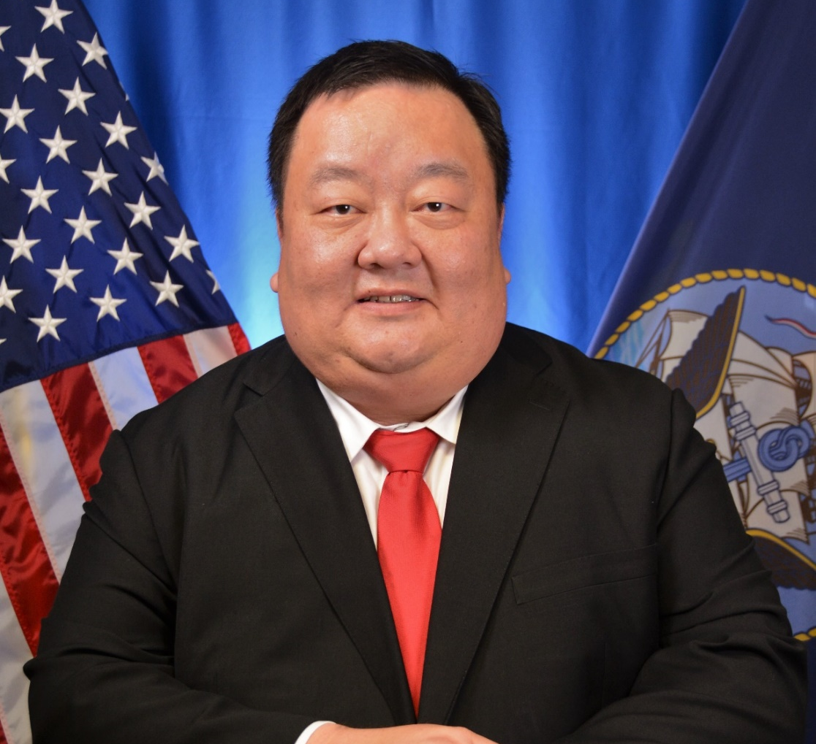
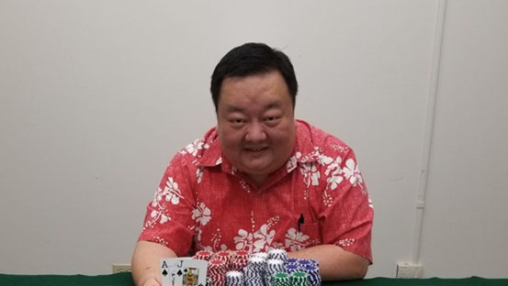
Tony Lau, P.E., ENV SP, F.ASCE Society Director - Region 8 Design Production Direction, NAVFAC Hawaii, Design and Construction Hawaii Section Honolulu, Hawaii

Slide 11
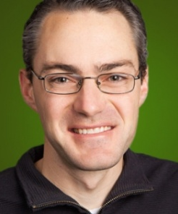
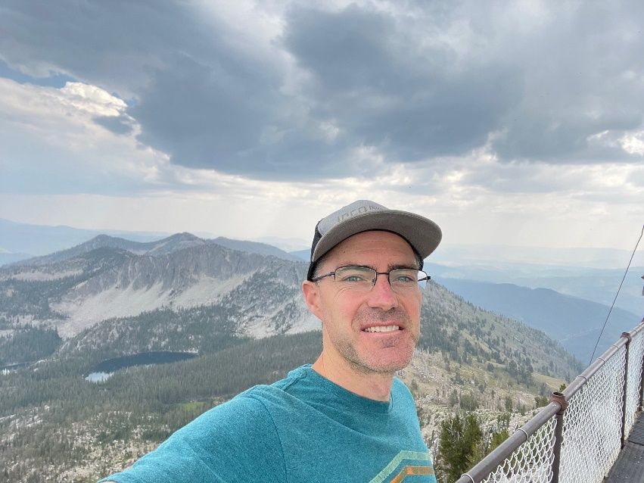
Seth Olsen, P.E., M.ASCE
Region 8 Treasurer & Historian
Senior Geotechnical Engineer
Innovate Geotechnical
Southern Idaho Section
Boise, Idaho

Slide 12
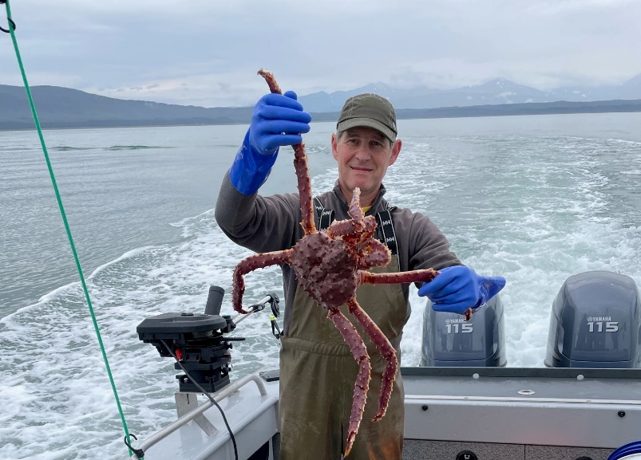
Lance Mearig, P.E., M.ASCE Region 8 Governor Southcoast Region Director Alaska Department of Transportation and Public Facilities (DOT & PF) Alaska Section Juneau, Alaska

Slide 13
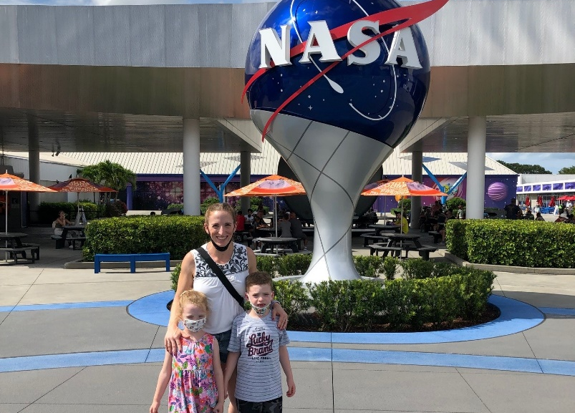
Kate Thompson, P.E., M.ASCE Region 8 Governor
Project Engineer
Anderson Perry & Associates
Columbia Section
Walla Walla, Washington

Slide 14
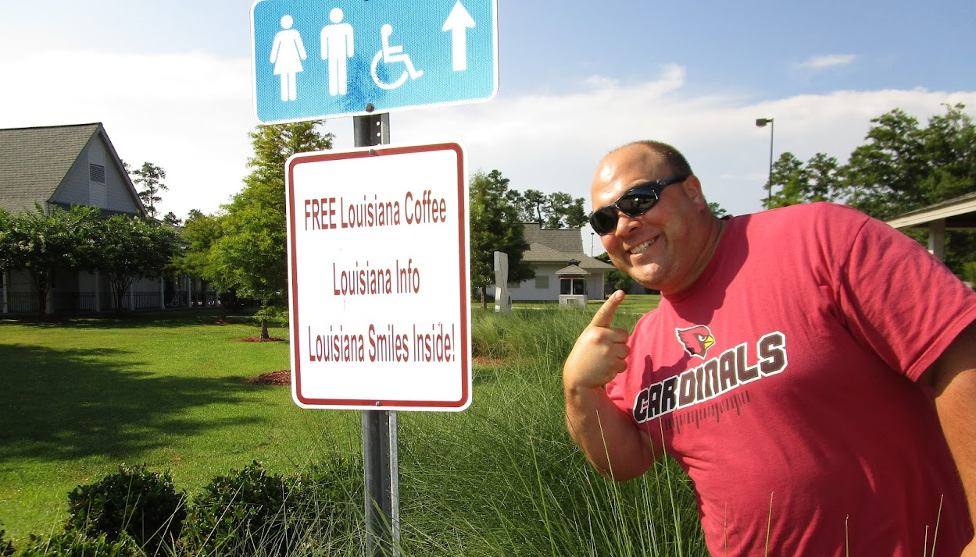
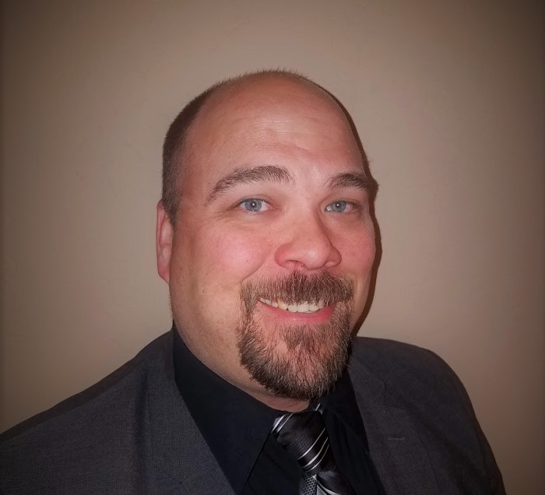
Mark Lamer, P.E., M.ASCE Region 8 Governor Faculty Northern Arizona University, Department of Civil Engineering, Construction Management and Environmental Engineering Arizona Section Flagstaff, Arizona

Slide 15
Matthew Roblez, S.E., M.ASCE Region 8 Governor Owner/Senior Structural Engineer McNeil Engineering Utah Section South Salt Lake City, Utah

Slide 16
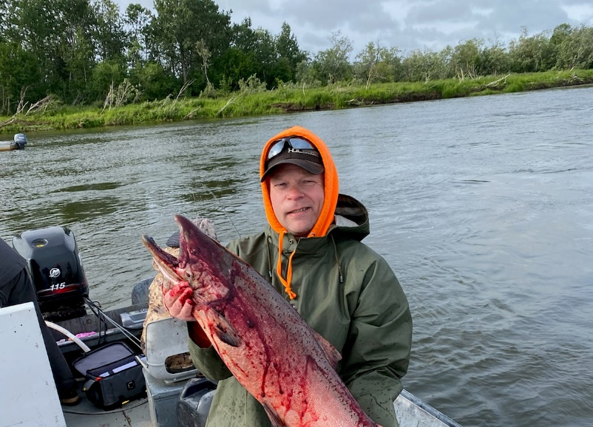
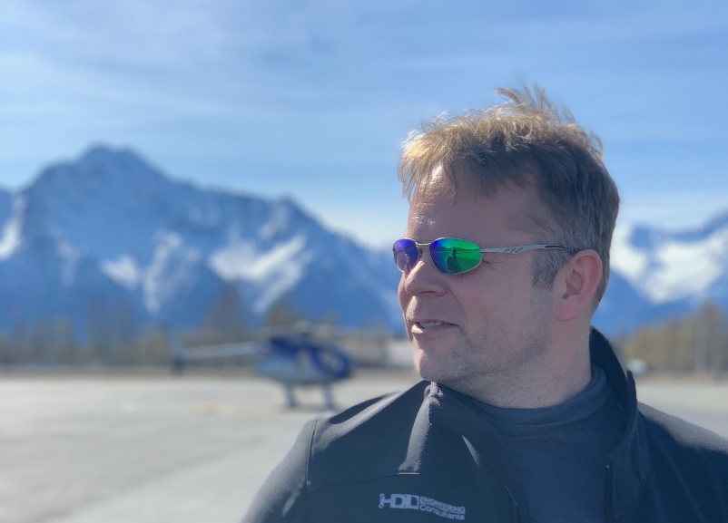
Tor Anderzen, P.E., F.ASCE Region 8 Governor
Senior Aviation Engineer
HDL Engineering Consultants
Alaska Section
Palmer, Alaska

Slide 17
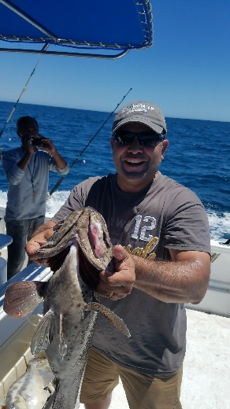
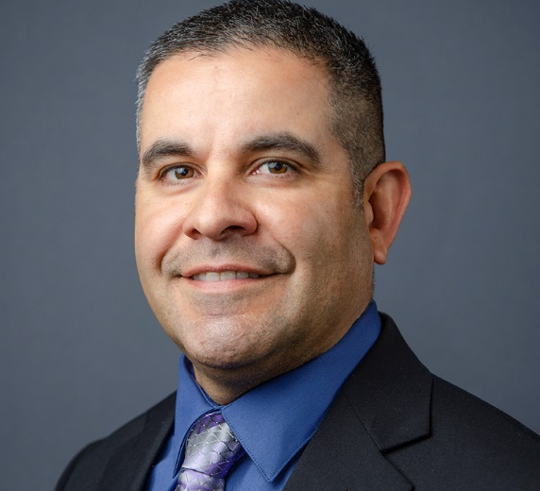
Fausto Burruel, P.E., MPA, M.ASCE Region 8 Governor Deputy Director Public Works Town of Marana Arizona Section Marana, Arizona

Slide 18
Dan Karlin, P.E., M.ASCE Region 8 Governor
County Engineer
Lewis and Clark County
Montana Section
Helena, Montana

Slide 19
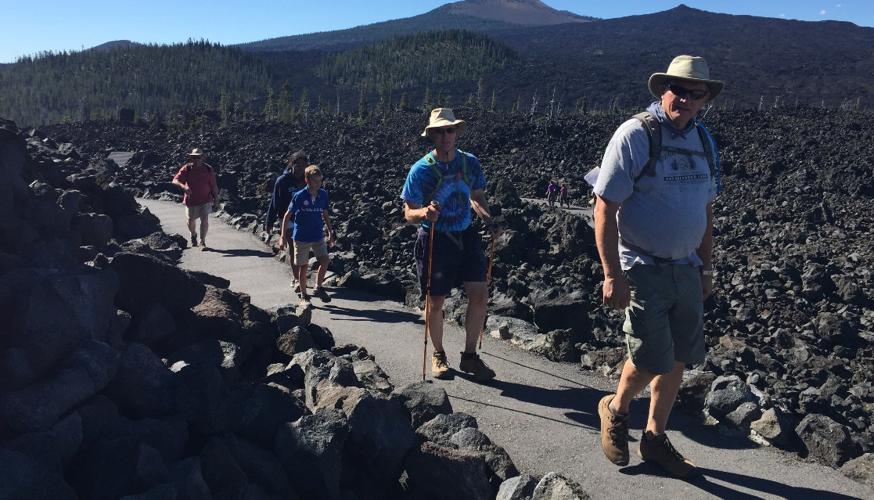
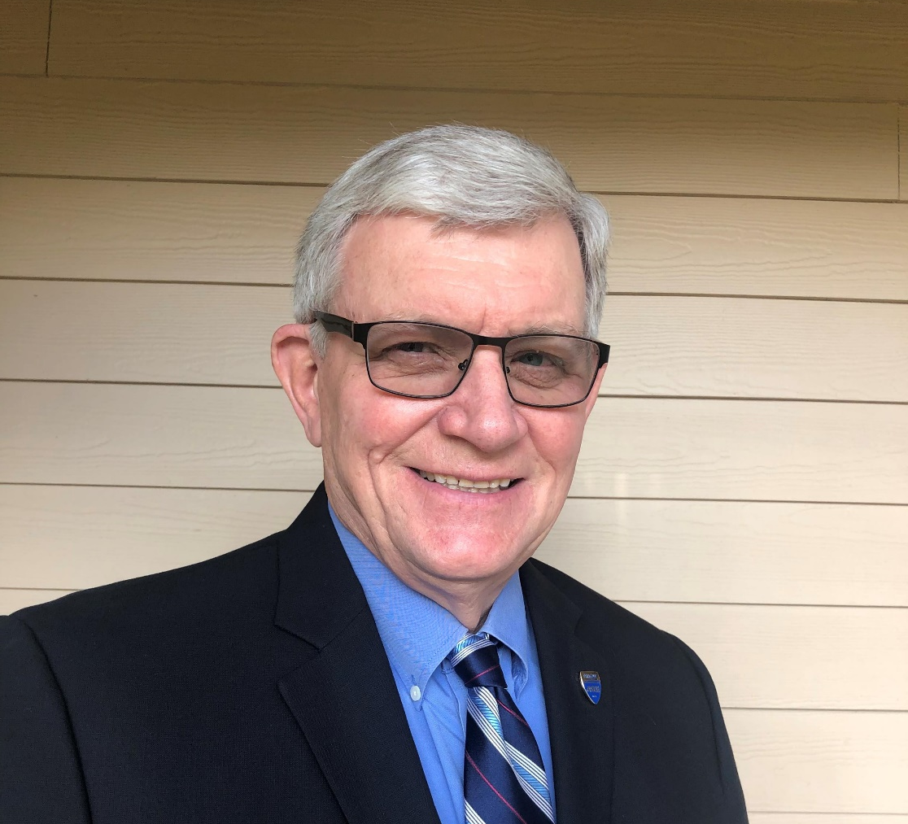
Larry Magura, P.E., F.ASCE Society Director-Elect, Region 8 Self-employed and Semi-retired Oregon Section Lake Oswego, Oregon

Slide 20
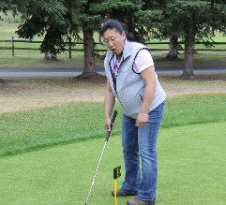
Virginia Groeschel, A.M.ASCE Region 8 Governor-Elect Consultant Coordinator , Aviation Design Engineer, Aviation Specifications Engineer, and Internship Program Manager Alaska DOT & PF, Central Region, Aviation Design Section Alaska Section Anchorage, Alaska

Slide 21
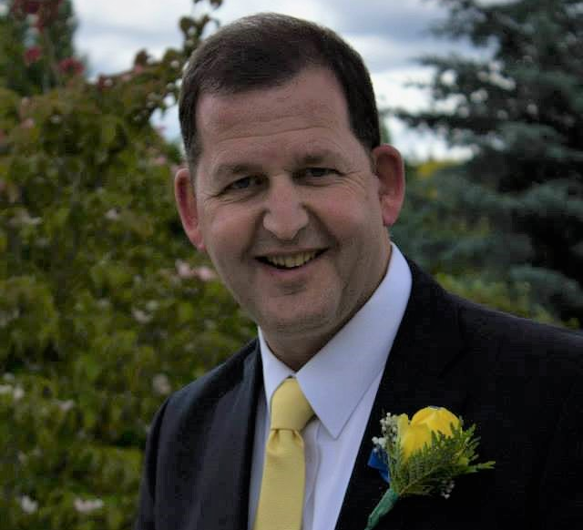
Bob Turner, P.E., F.ASCE Region 8 Governor-Elect Project Manager Spokane Public Schools Inland Empire Section Spokane, Washington

Slide 22
ASCE Region 8 Organizational Chart 2022
Chair/Society Director Larry Magura
Oregon Section
Governor/ Vice-Chair Mark Lamer
Arizona Section
Governor/ Secretary Virginia Groeschel
Alaska Section
Governor Bob Turner
Inland Empire Section
Governor Matthew Roblez
Utah Section
Governor Tor Anderzen
Alaska Section
Governor Fausto Burruel
Arizona Section
Governor Dan Karlin
Montana Section
Committees Finance (Chair), Students (Co-Chair)
Liaison to Arizona Section, Intermountain Southwest Student Conf
Committees Awards (Chair), Nominations (Chair), Social (Chair)
Liaison to Utah and Southern Idaho Sections and Intermountain Southwest Student Conf
Committees
Resolutions (Chair), Government Relations Liaison
Liaison to Nevada and Oregon Sections and Intermountain Southwest Student Conf
Committees Western Canada Outreach (Chair), Membership (Chair)
Liaison to Seattle and Tacoma -Olympia Sections and Pacific Northwest Student Conf
Committees
Conferences (Chair), Finance
Liaison to Hawaii and Montana Sections
Committees Communications (Chair)
Liaison to Alaska Section, Pacific Northwest Student Conf
Committees Students (Co-Chair), Finance
Liaison to Columbia and Inland Empire Sections, Pacific Northwest Student Conf
Treasurer/Historian Seth Olsen
Southern Idaho Section

Slide 23
THANK YOU!
#REGION8ISGREAT

